Slide 1
Events Management: Principles & Practice, 4th Edition
By Razaq Raj and Tahir Rashid

Slide 2
Chapter 2 Events Destinations Management
Events tourism
Cultural tourism
The development of cultural tourism into niche tourism
Festivals destinations
Developing communities culture through events / festivals
Managing visitors for events
Cultural and economic impacts

Slide 3
Events Tourism
Events have the potential to generate a vast amount of tourism when they cater to out-of-region visitors.
Tourism related services, which include travel, accommodation, restaurants, shopping are the major beneficiaries of the event.

Slide 4
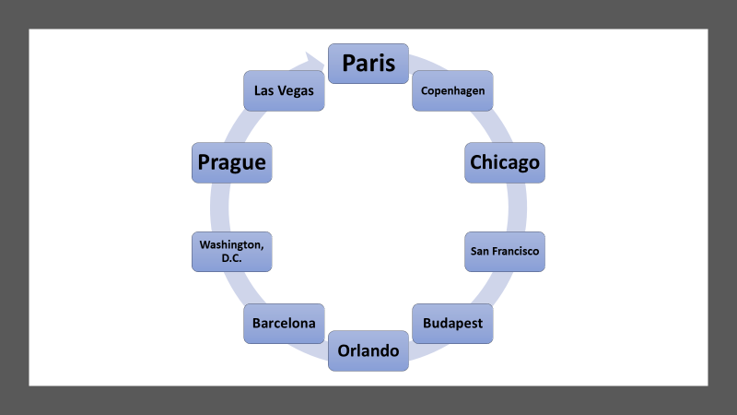
Top Global Destinations for Meetings and Conferences 2019
Source: Global DMC partners, 2019

Slide 5
UK Events Tourism:
In 2018 the UK welcomed 8.4 million business visits
In 2018 business visits accounted for over 1 in every 5 visits to the UK (22%)
Business visitors spent £4.5 billion in the UK during 2018.
Despite the recent slowdown in the last couple of years, in 2018 visits and spend were still well above the low point in 2009: +28% in visits and +22% in spend.
Business visits in the first six months of 2019 were up 1% on January-June 2018 and business spend up 9%
Source: Visit Briton, Understanding Business Visits (2018, p.10)

Slide 6
Cultural tourism
Today festivals are considered to contribute significantly to the cultural and economic development wealth of the United Kingdom.
Festivals have major impacts on the development of cultural tourism to the host communities.

Slide 7
Cultural Tourism
Culture is a main attraction of tourism. Without culture to make a difference, a tourist site would be a less interesting place.
Without different cultural heritages, therefore, places across the world would have little to offer as attractive tourist sites.

Slide 8
Cultural Tourism
Type of Cultural Tourism
Performing Arts
Historic Sites and Monuments
Educational Tours
Natural Heritage Sites
Museums
Religious Festivals

Slide 9
The development of cultural tourism into niche tourism
Festival organisers are now developing Niche tourism.
Using historical and cultural themes to develop a calendar of annual events to attract tourist visitors.
Festivals and events are not specifically designed to address the needs for any one particular group.

Slide 10
Developing communities culture through events / festivals
Host communities play a major role when running a major sporting event or any other large scale event.
A host community may have a problem with the event due to influx of visitors.
This may have a knock on effect in terms of traffic congestion and negative social impact

Slide 11
Developing communities culture through events / festivals
Festivals have both positive and negative impacts on their host cities.
The emphasis is often focused on the economic analysis.
The community festivals now play a significant role in income generation for the local businesses and create tourism for the local area.

Slide 12
Essential Activities for Events Visitors

Slide 13
Managing visitors for events
Hosting and staging events as part of tourism strategies.
Tourism agencies and national governments promoting community festivals.
Events can shape tourist perceptions of a region.

Slide 14
Summary
Festivals can be big business for a destination.
Festivals become part of destination tourism strategies
Local authorities are using events to position their destinations in the market.
The festivals have contributed in the development of events and cultural tourism.

Slide 15
Further Reading
McCorkell, A. (2019) Global DMC Partners https://www.citmagazine.com/article/1663237/will-top-destinations-events-incentives-2020 [accessed 03/04/2020].
Notting Hill Carnival: A Strategic Review (2004) Published by Greater London Authority www.london.gov.uk
Visit Britain (2018) Understanding Business Visits Foresight – issue 172. https://www.visitbritain.org/sites/default/files/vb-corporate/DocumentsLibrary/documents/foresight_172_-_understanding_business_visits.pdf[accessed 19/03/2021].
www.keynote.co.uk

